Slide 1
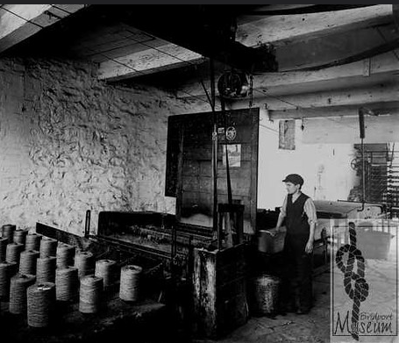
Rope & Net Making
in Pictures
Part 1: Twine

Slide 2
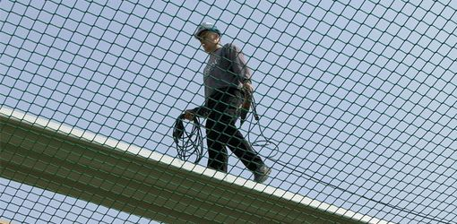
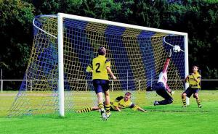
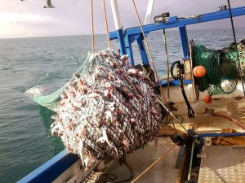
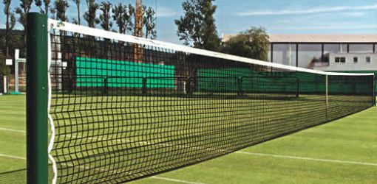
Here in Bridport, we have a long history of rope and net making, going back to 1213. But we still make rope and nets today. Take a look at the websites for local companies like Amsafe, Huck Nets Ltd., Coastal Nets Ltd. to see what they do. Or you might know people who work there.
The pictures in this pack show you how nets and rope used to be made in Bridport and its surrounding villages.

Slide 3
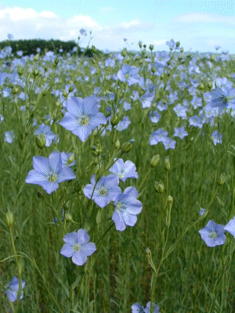
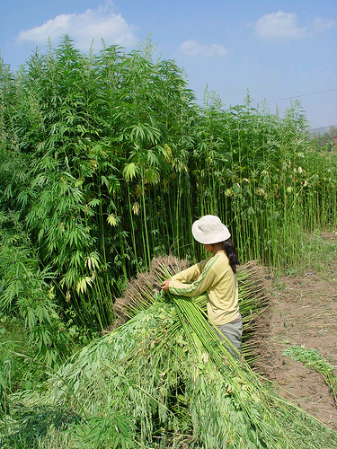
Modern rope & nets are usually made from artificial fibres, but in the past they were made from natural fibres like flax and hemp.
Flax is like a tall grass with beautiful blue flowers and it used to be grown all over West Dorset. The flax plant has long stringy fibres in its stem, and these are what we use to make nets. To get the fibres out of the stems we soak the whole plant in water until all the outer parts go soft and slimy and can be washed off
.
Hemp plants are much bigger. They also have long, stringy fibres in the stems, but the fibres are tougher and coarser than flax, so hemp was used for ropes which needed more strength.

Slide 4
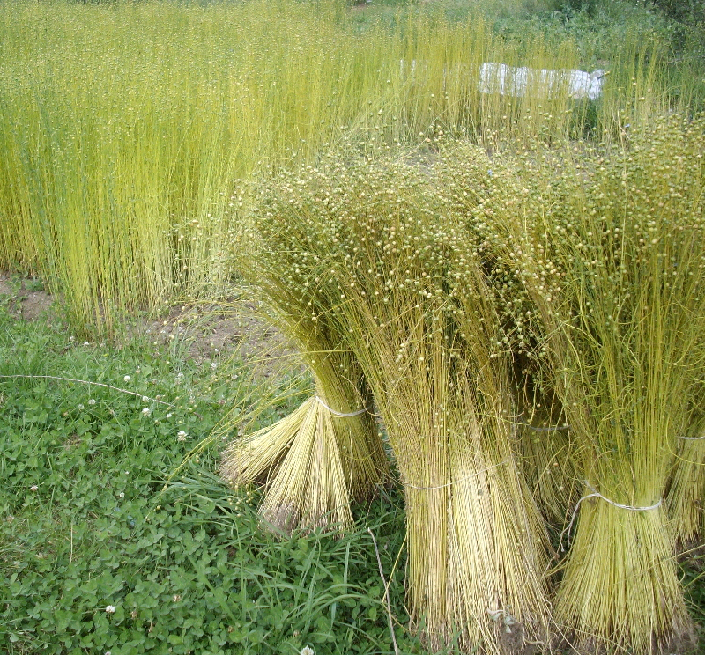
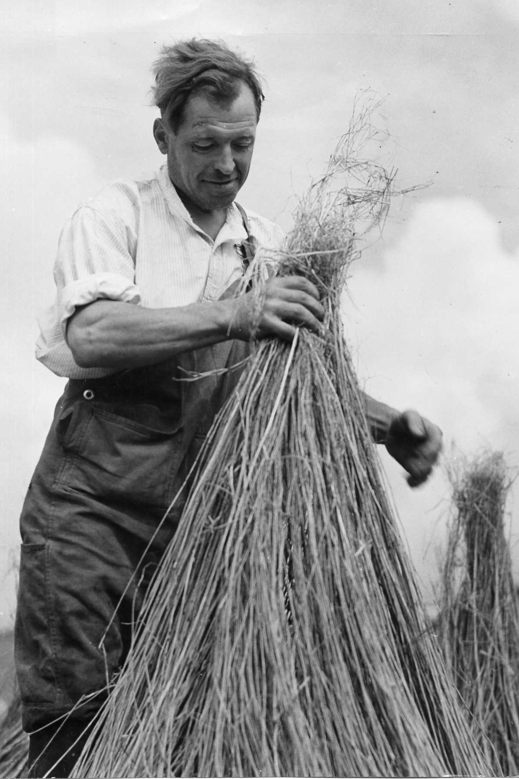
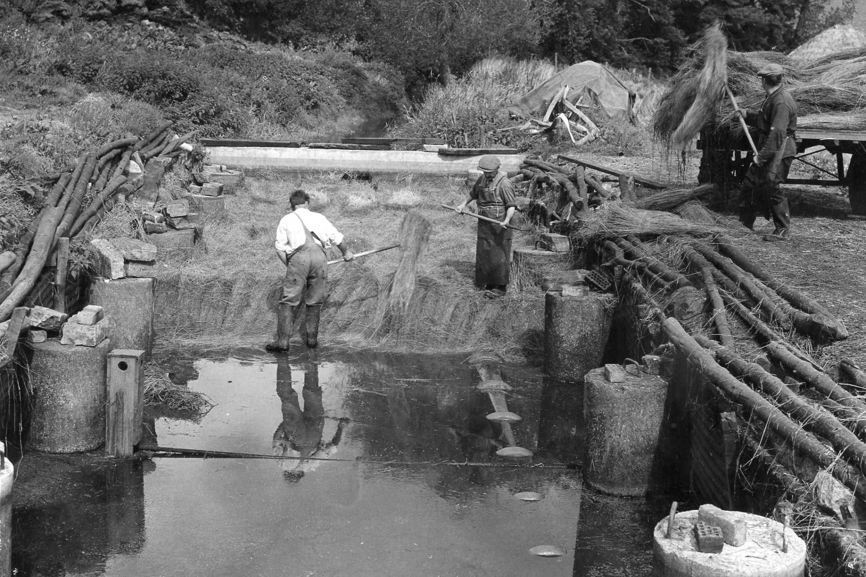
1
The harvested flax is tied into bunches, but like this the stalks are too tough and you can’t get to the fibres we need to make twine. So we look for a river…..
Bundles of flax are soaked in running water in the river for several days. This loosens the fibres inside the plant stalks. It’s called “Retting” the flax.
3
2
The flax is “stooked” to dry it. Then it’s ready to go to the mill.

Slide 5
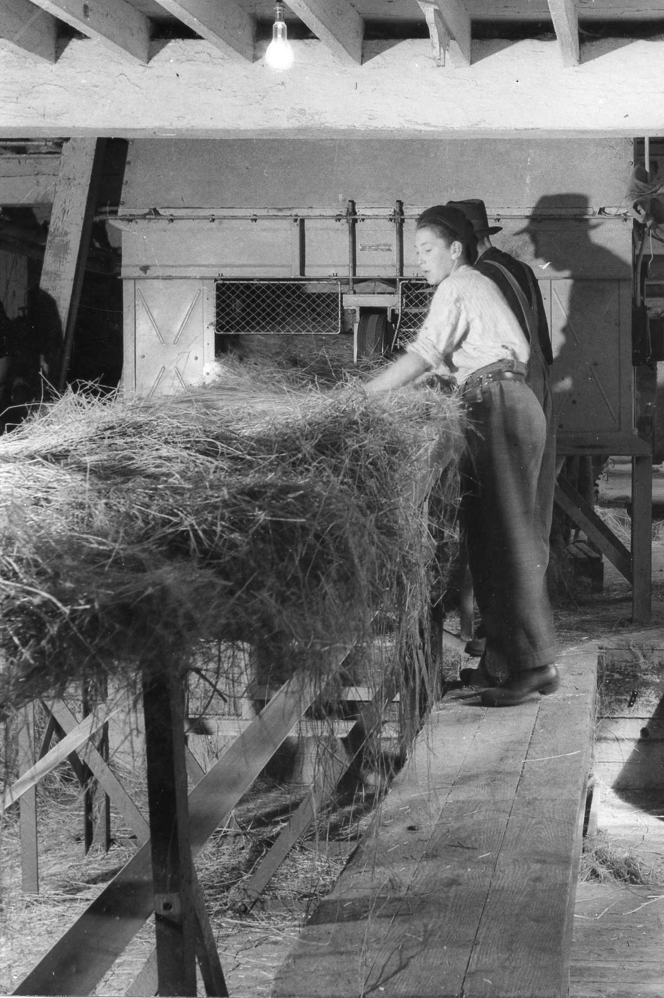
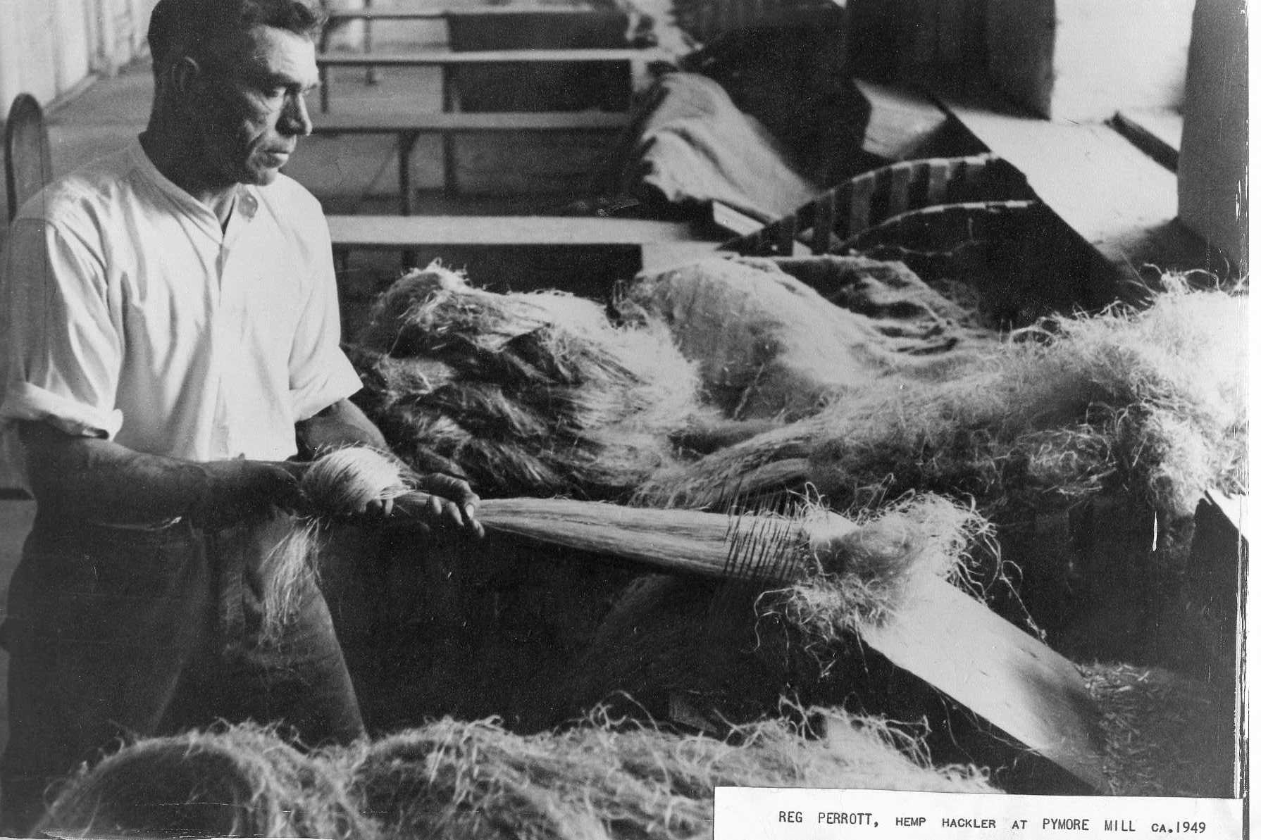
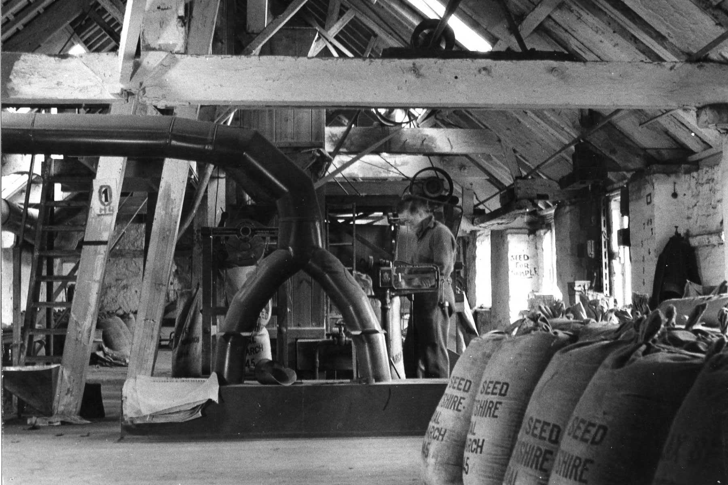
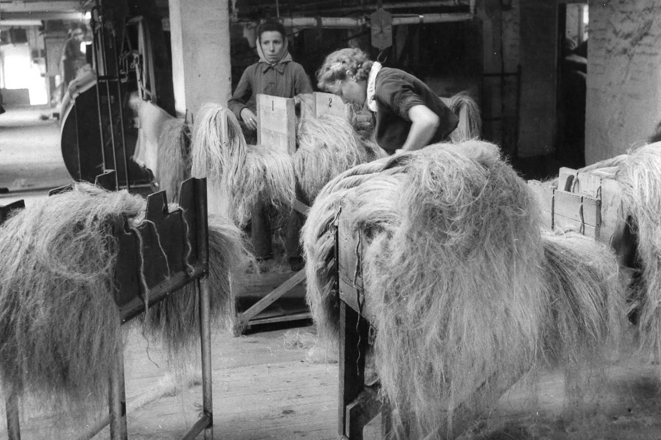
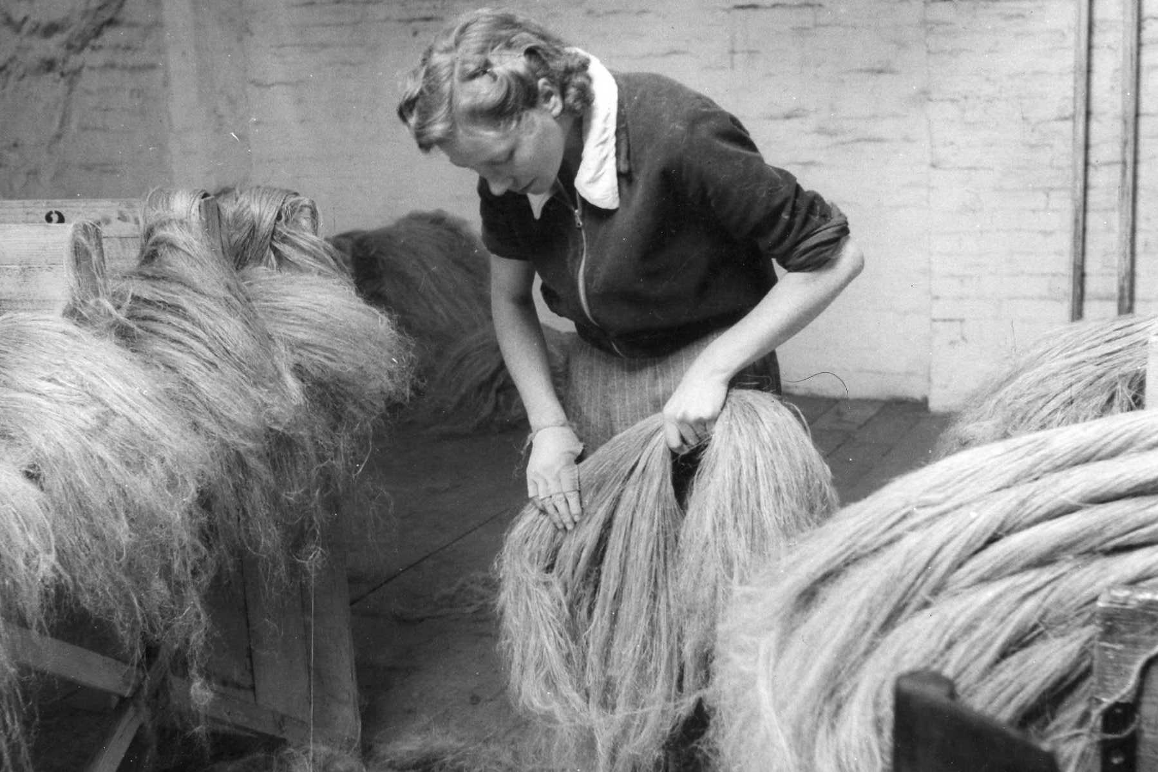
1
When the dry flax arrives at the mill it’s carried by a moving belt to the machine that “dresses” it. The stalks are broken open and the long fibres separated. This job used to be done by hand, on local farms.
2
Bunches of flax are pulled through metal spikes to untangle the fibres into straight lengths ready for spinning. This is called “hackling” flax.
3
4
The flax comes out of the “dressing” machine. it’s sorted into different grades and bundled. Then it’s ready to go to the spinning mill to be made into twine.
When the flax is dressed, the seeds are taken out of the plants, dried, put into sacks and planted for next year’s crop.

Slide 6
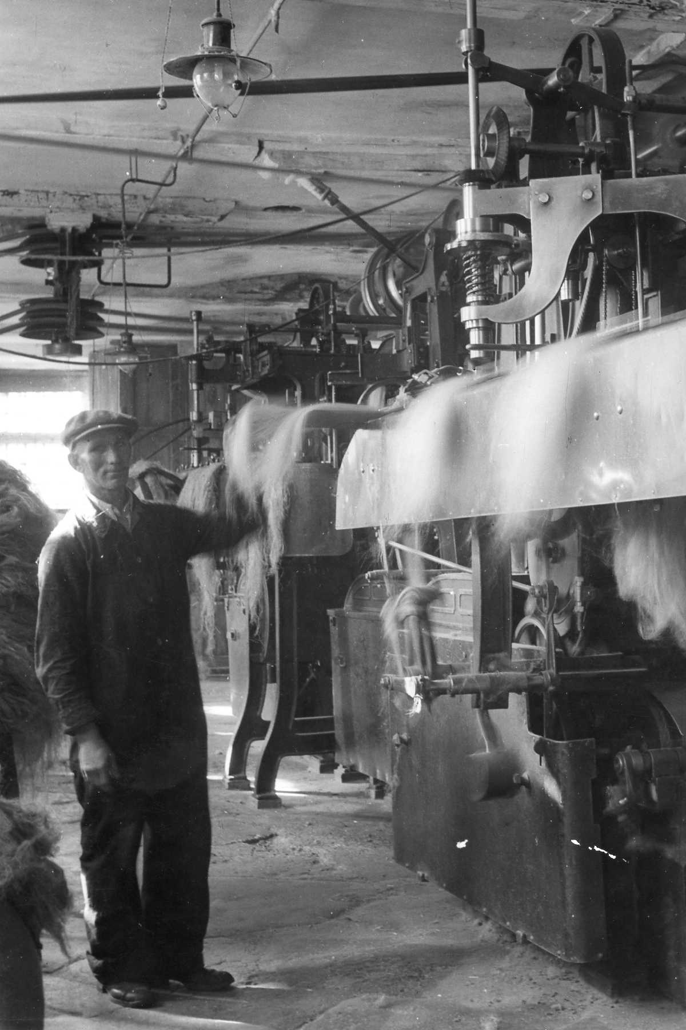
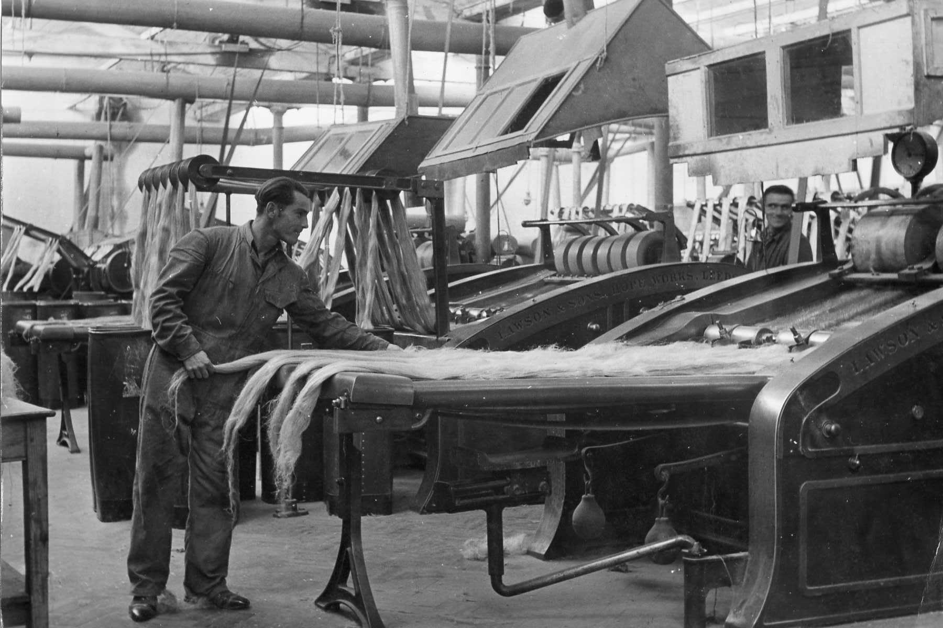
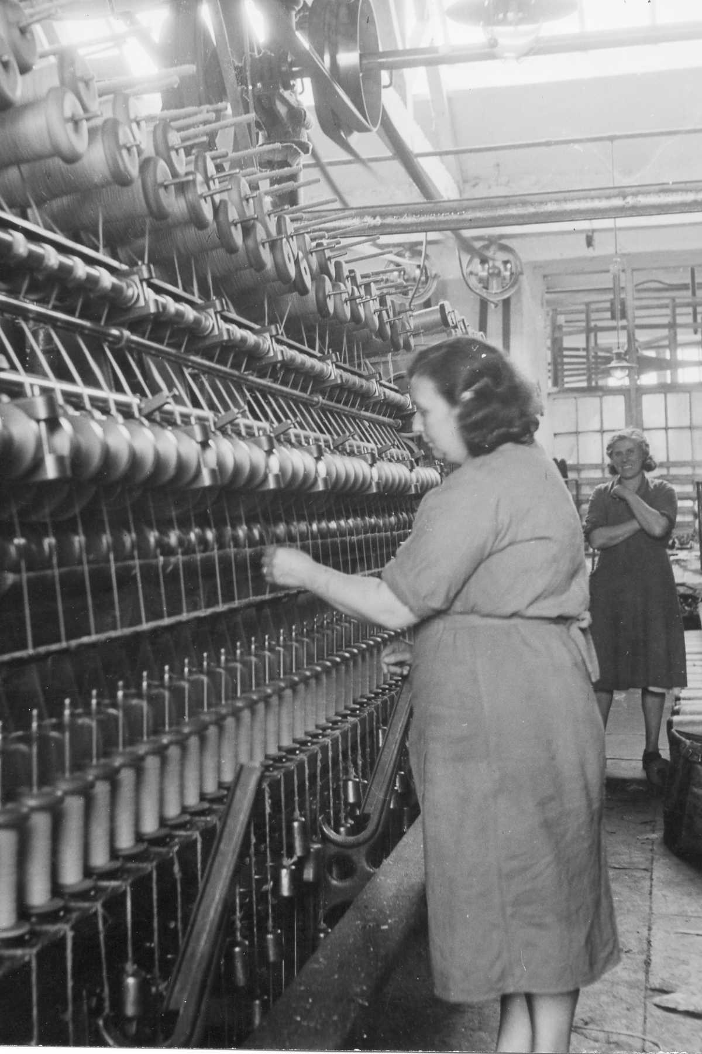
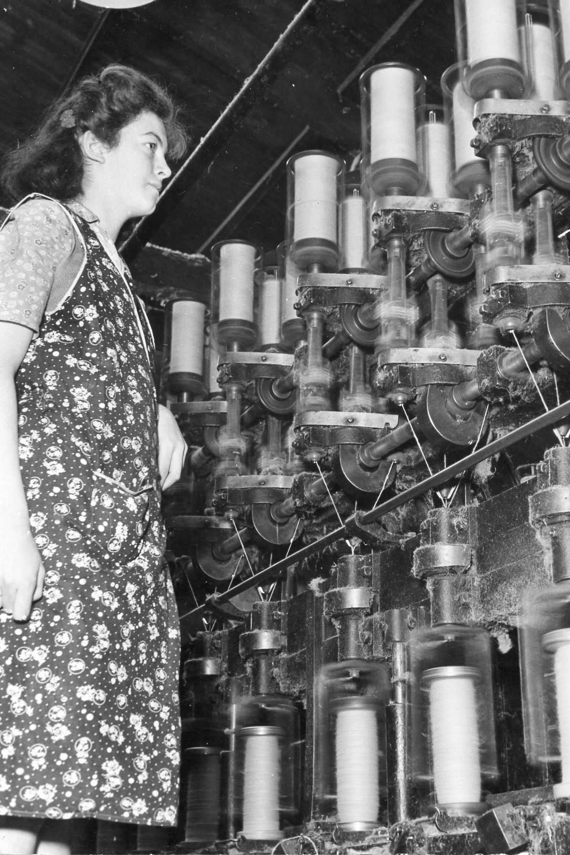
1
At the spinning mill, the flax is dressed once more.
The flax is laid out in thin sheets and rolled to make an even layer for the spinning machines
2
3
4
This is the spinning machine. Here the individual fibres of flax are stretched, twisted together, and wound onto wooden rolls called “bobbins”.
This machine was VERY noisy but the women don’t have ear defenders!

Slide 7
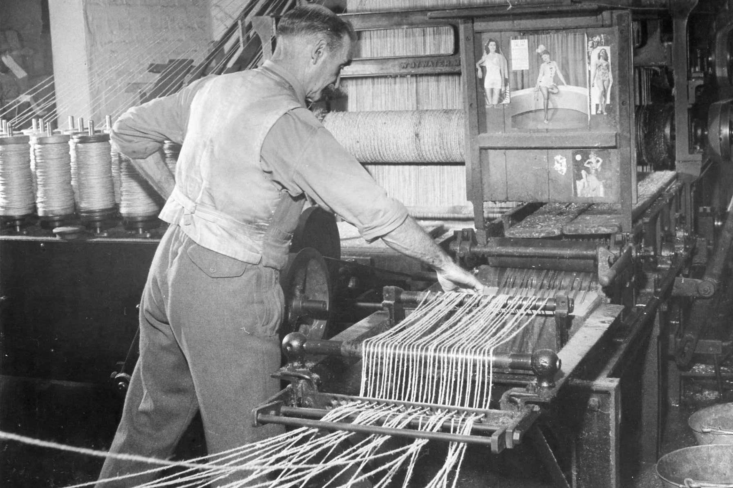
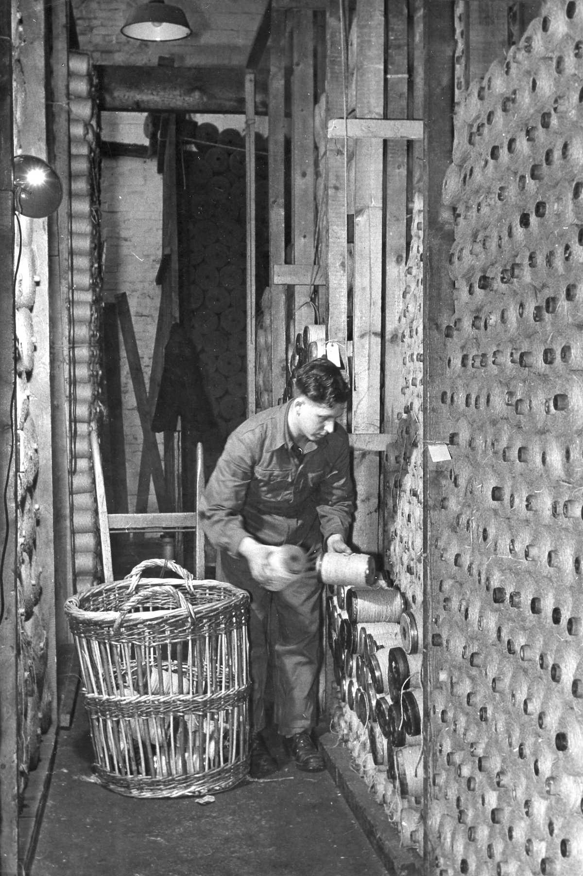
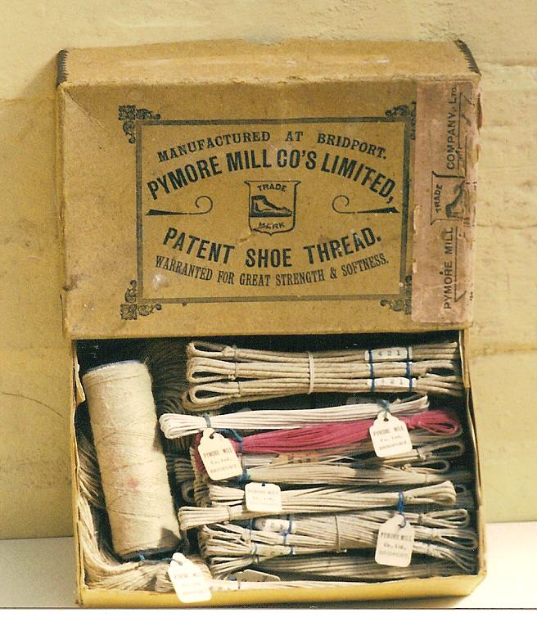
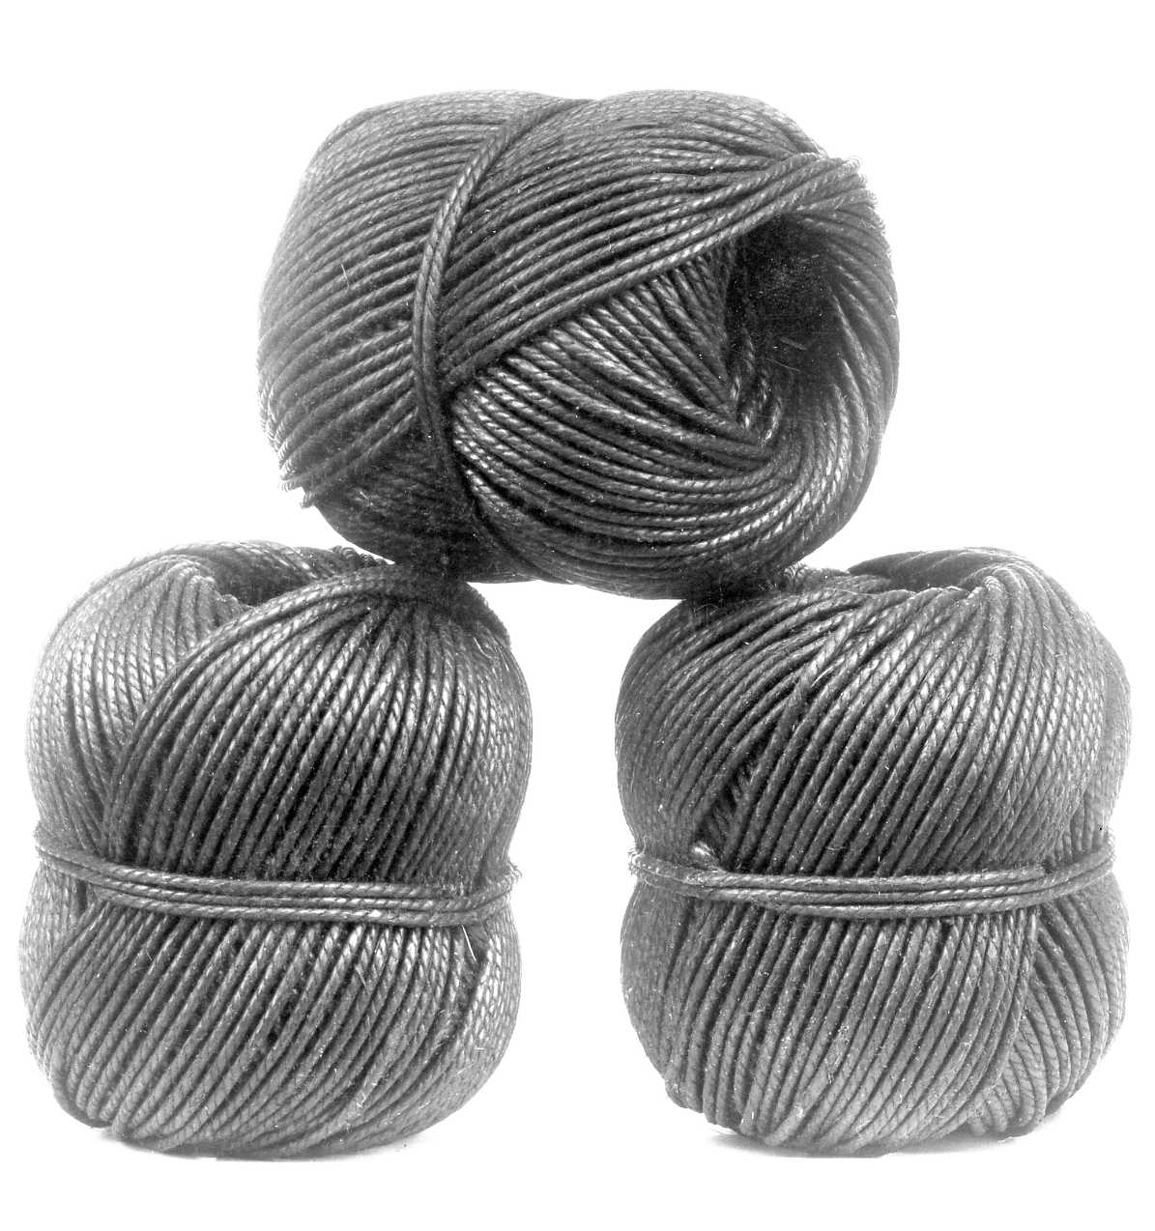
1
After the flax is spun into twine it is coated in “size” (a kind of paste) to seal it, and polished in this machine.
2
3
The mill store room is full of spools of finished twine.
Finished, polished twine ready for making into lines, nets or rope
Made in Bridport!

Slide 8
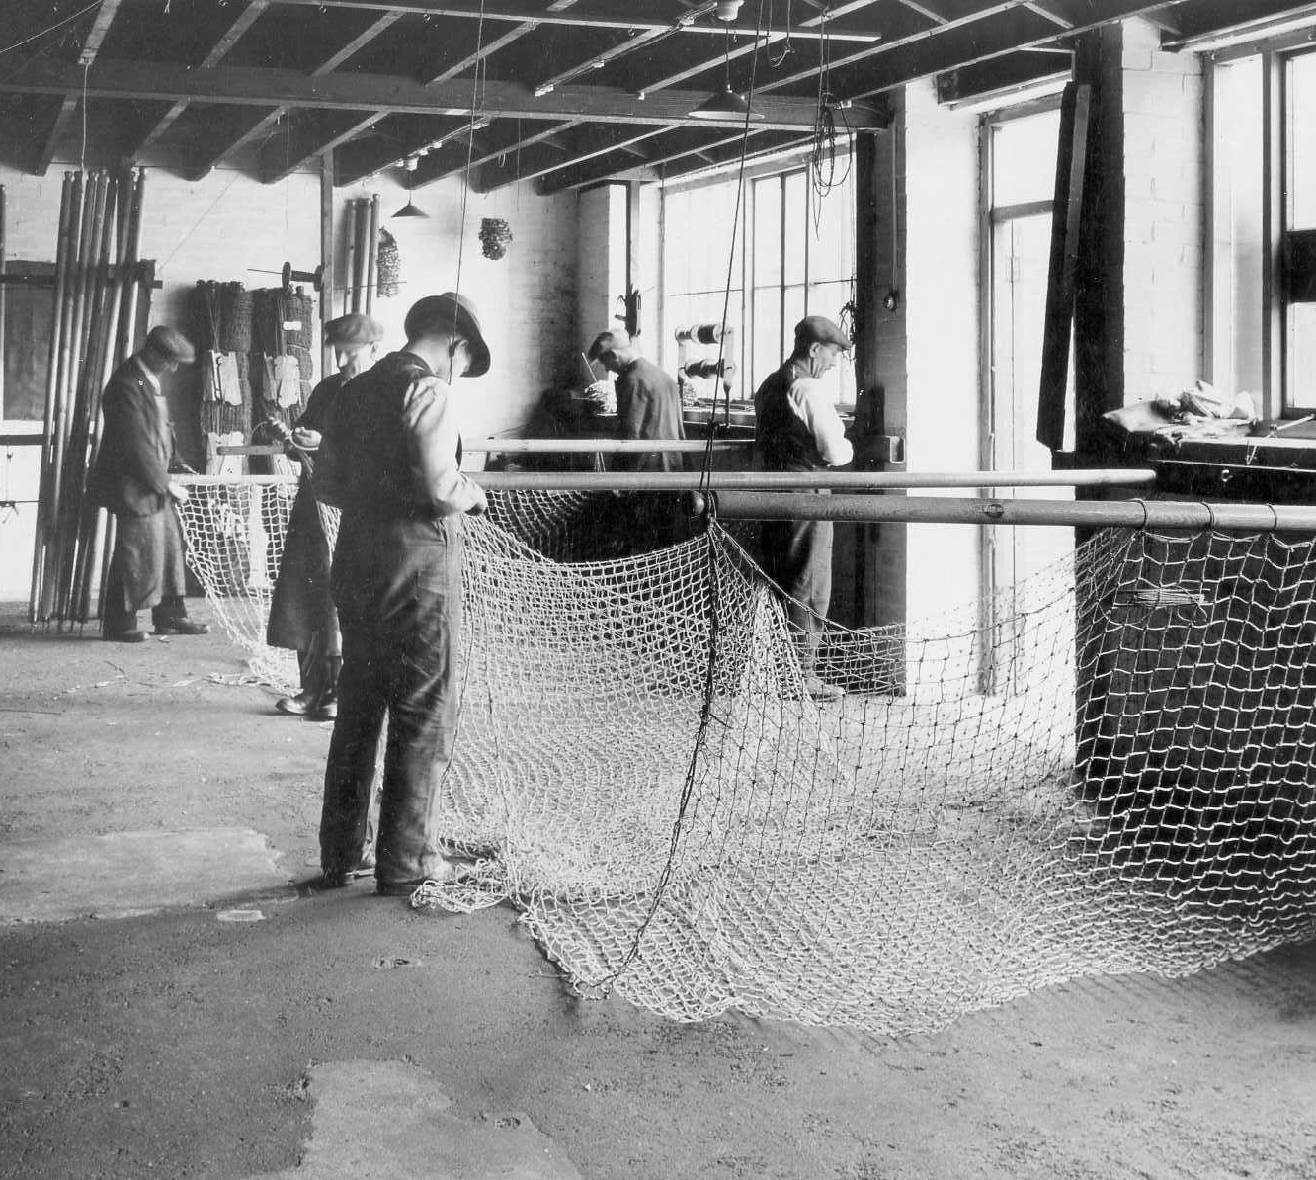
Rope & Net Making
in Pictures
Part 2: Nets

Slide 9
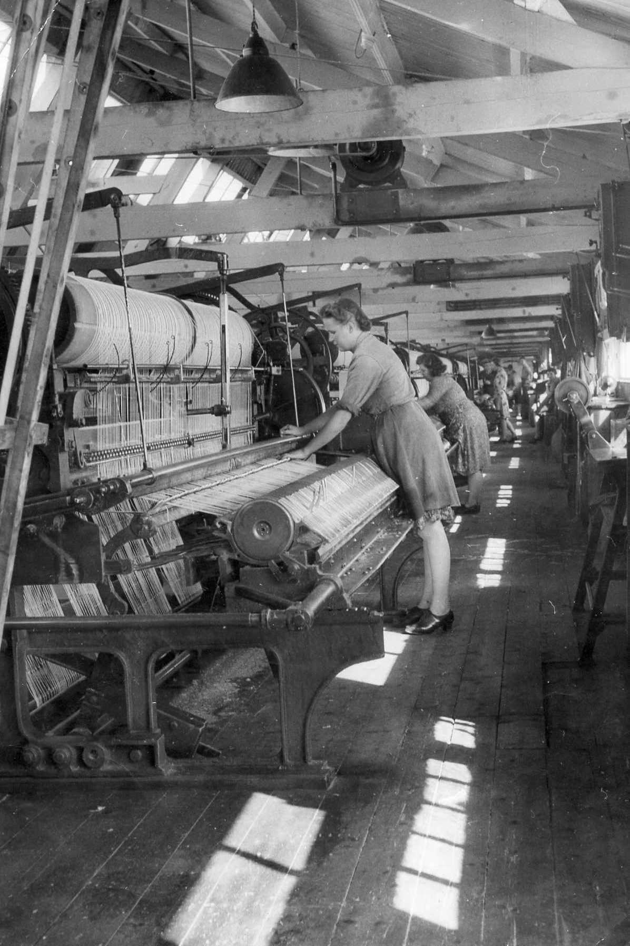
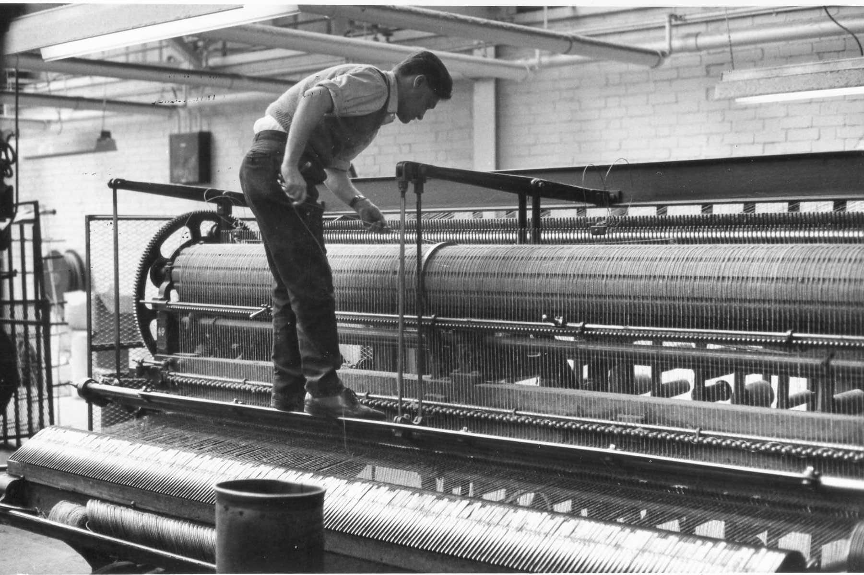
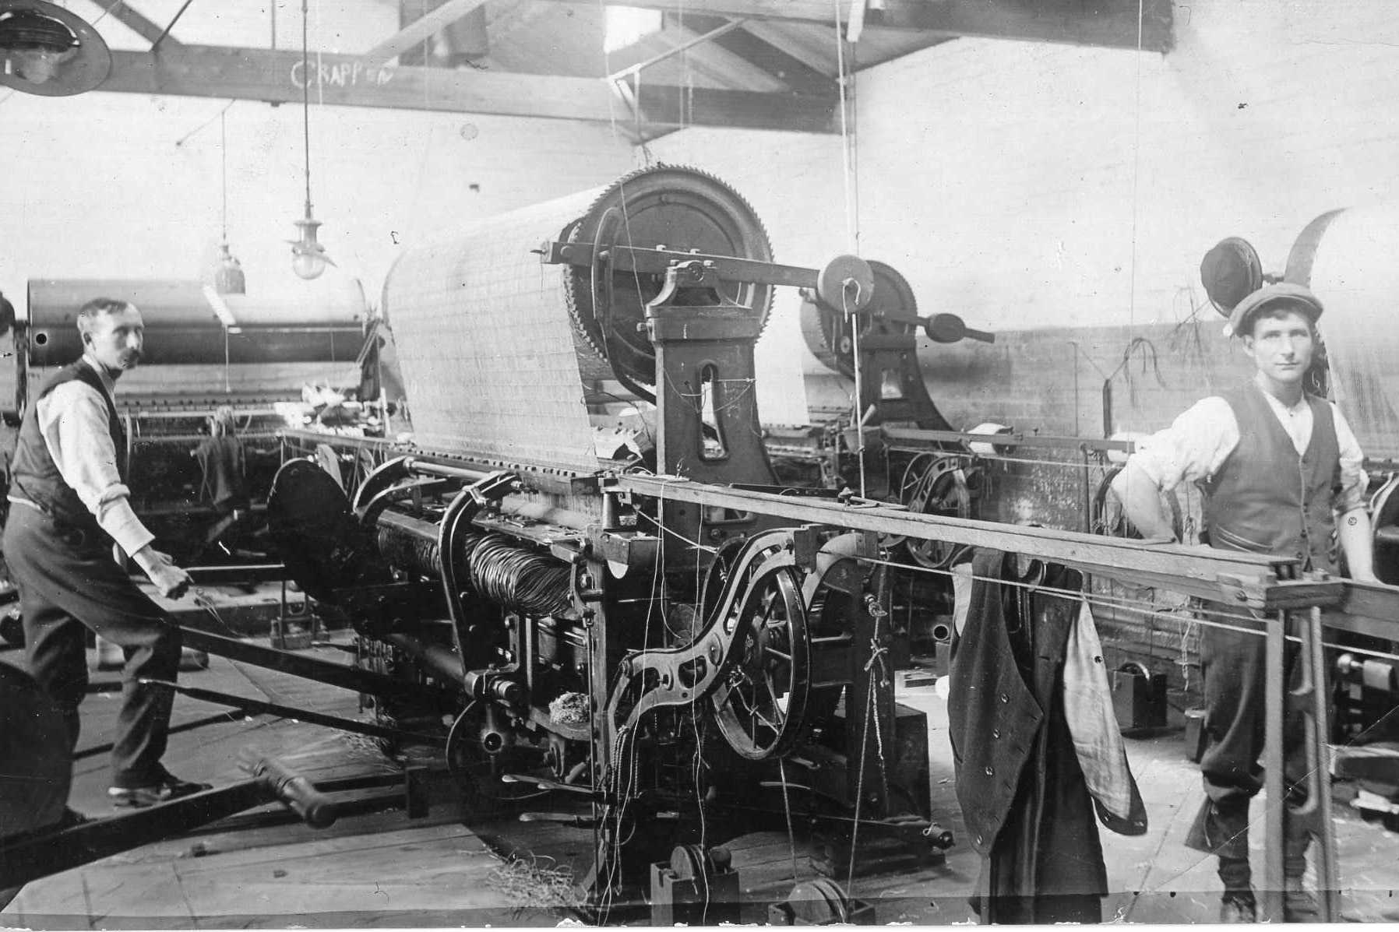
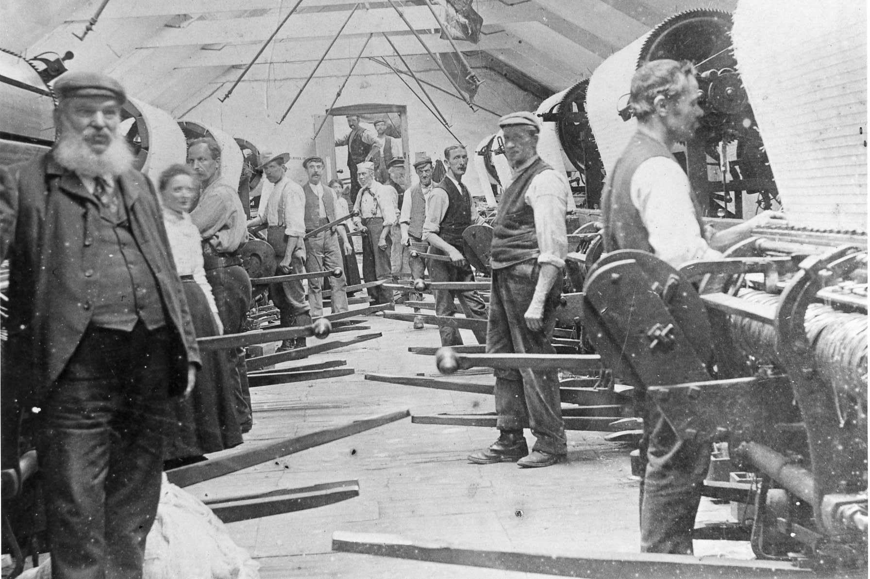
Some thoughts about Health & Safety…
The spools of finished twine were set up on the net making loom. Look how long the weaving shed is. Imagine the noise. Imagine standing up all day, bending over the moving machines.
If the machines needed attention you had to climb on to them
Men tied their trouser legs tightly to prevent their trousers getting caught in the machines.
An older picture inside another mill. You had to be careful not to trip on the levers and bars sticking out from the machines.

Slide 10
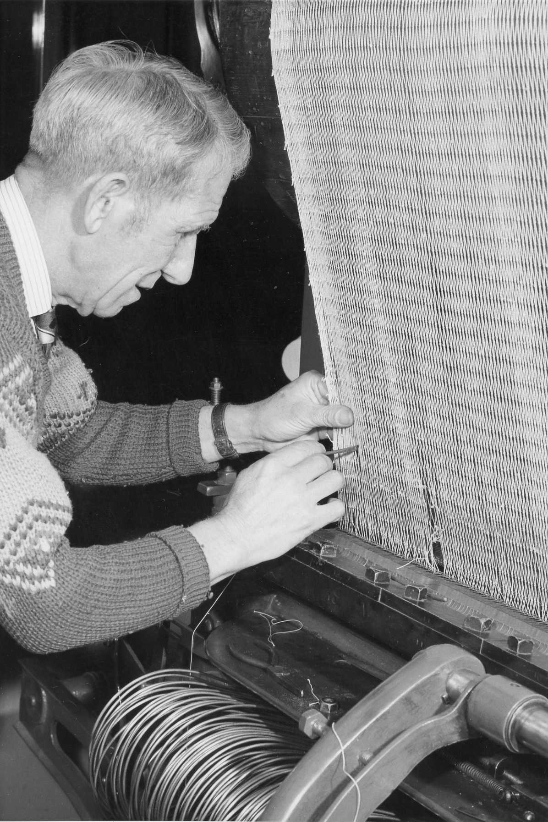
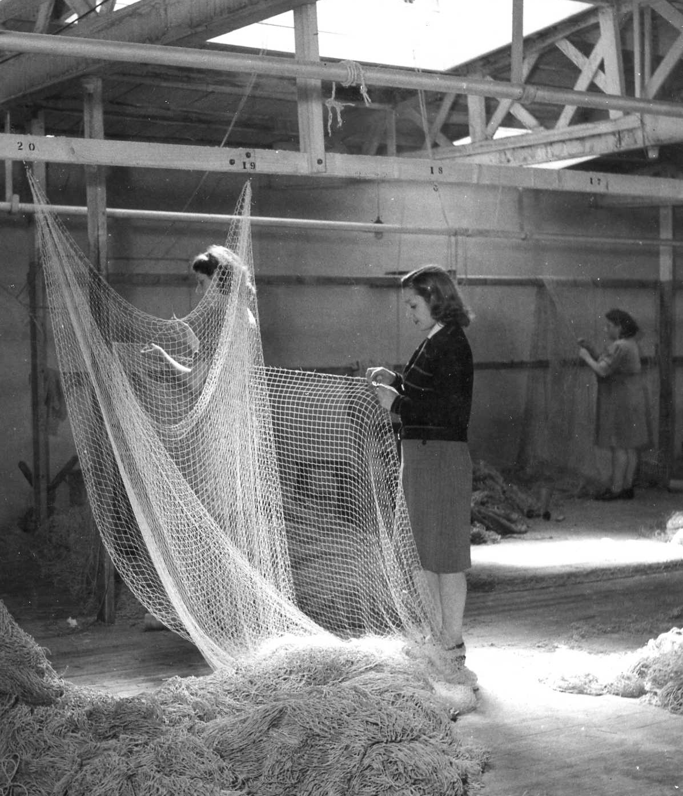
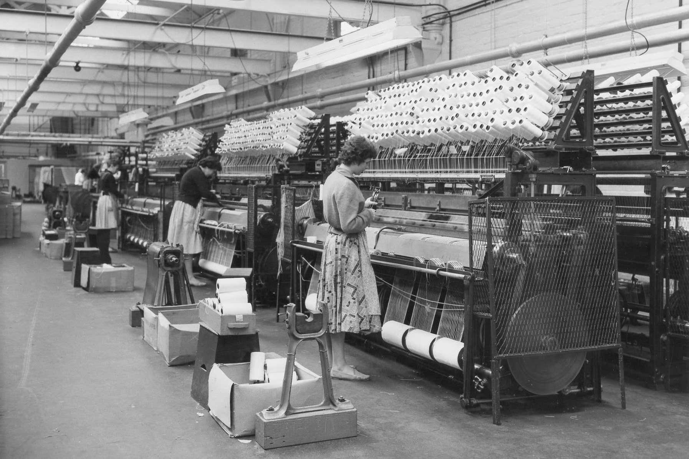
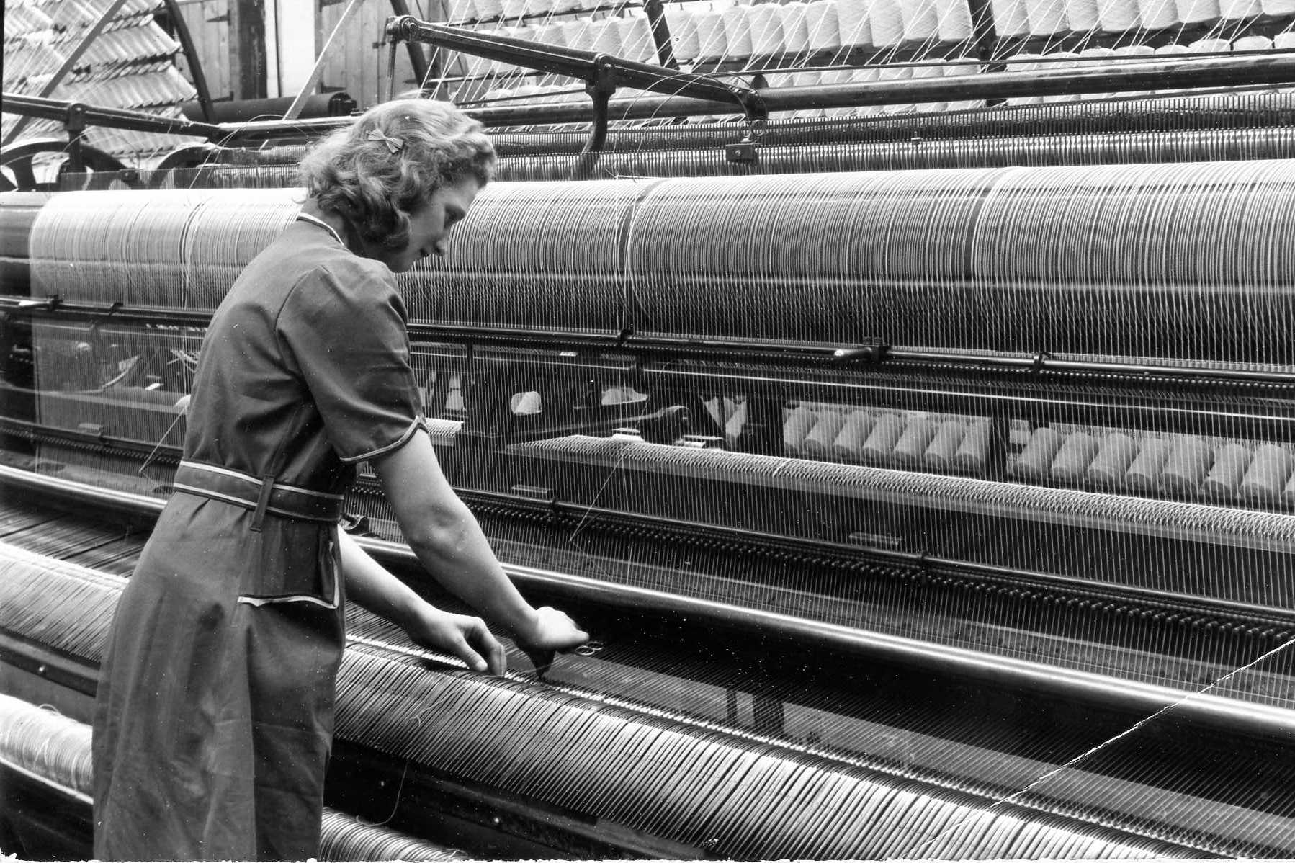
The net making machines took long lengths of twine and tied them into knots to make nets. But if the twine broke, the operator had to tie it back together.
This big fishing net is nearly finished. It will be stretched, coated in tar to make it waterproof, and finally have corks fitted to the top and lead weights to the bottom. This particular net was sold to salmon fishermen in Canada
These pictures show bigger, more recent machines. You can see hundreds of bobbins of twine at the top, ready to be made into nets.

Slide 11
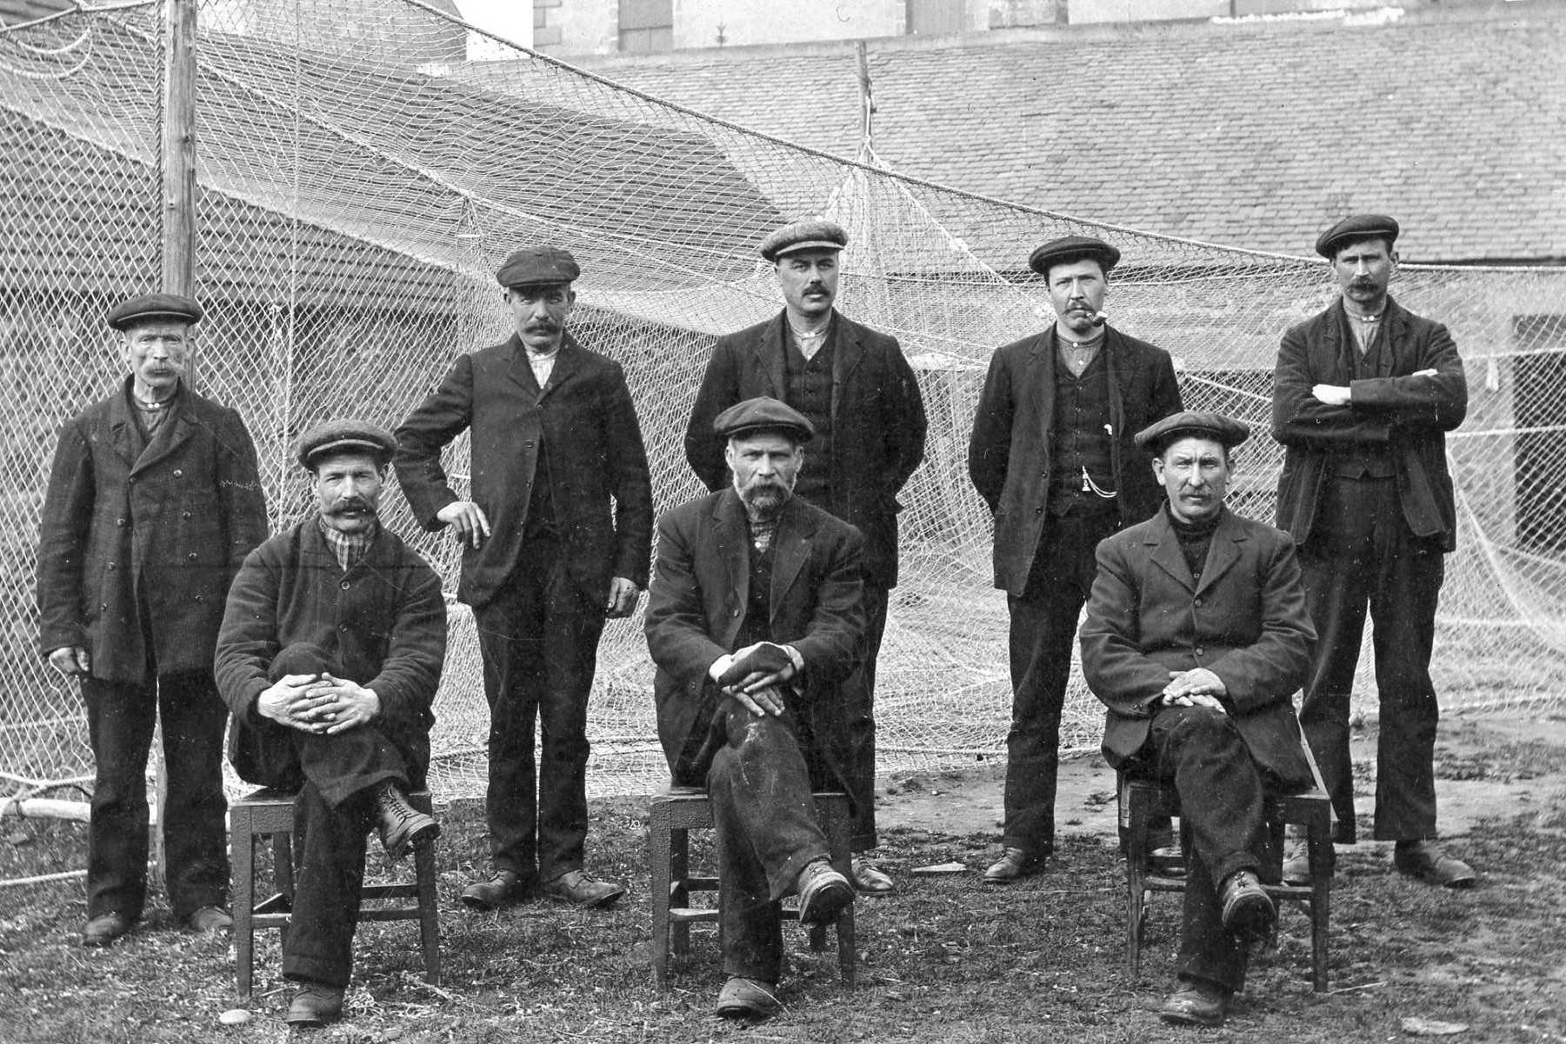
Some workmen pose outside the net factory, with finished nets being stretched on frames behind them. The man in the middle has a leather guard on his hand to protect his fingers from getting cut by the hard twine.

Slide 12
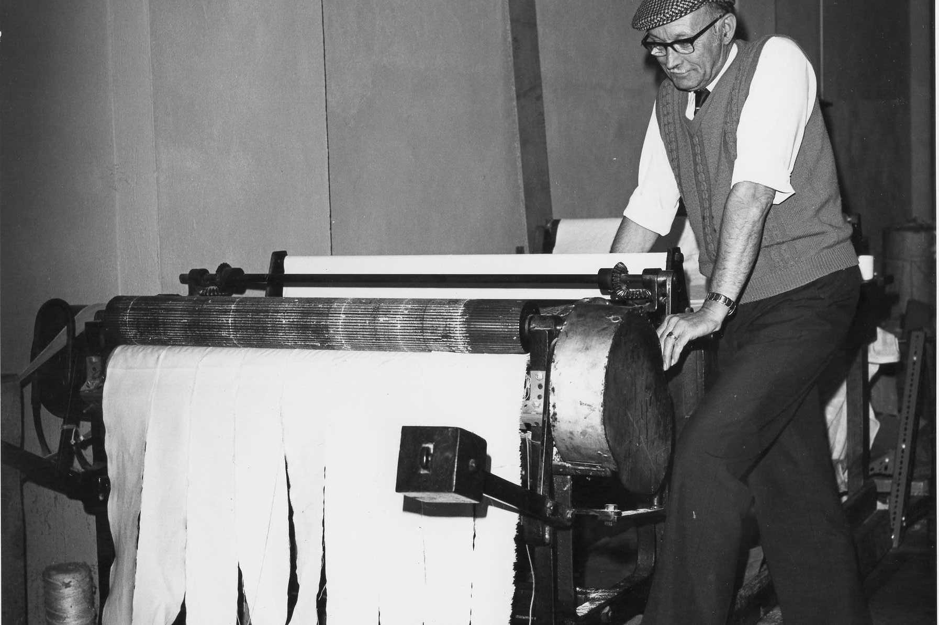
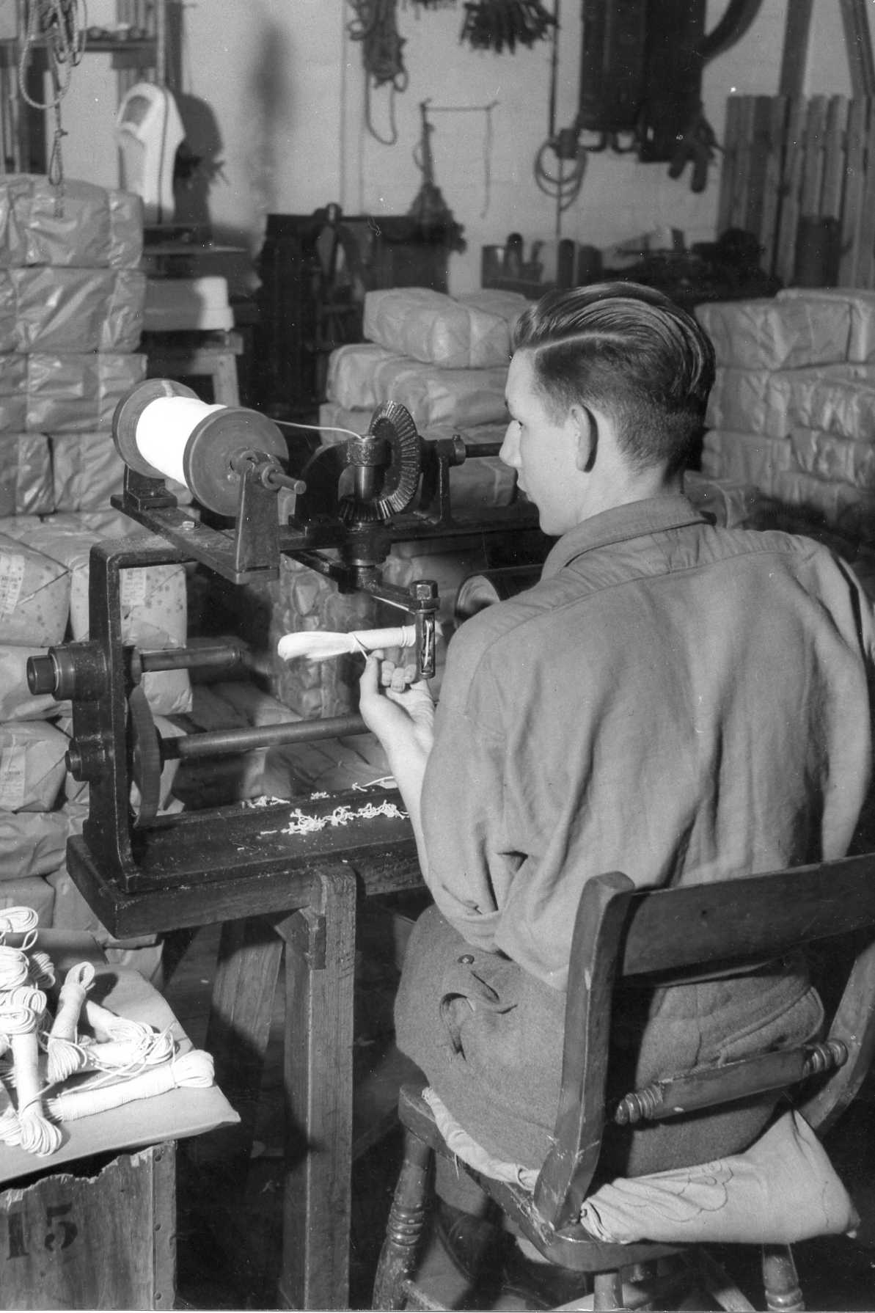
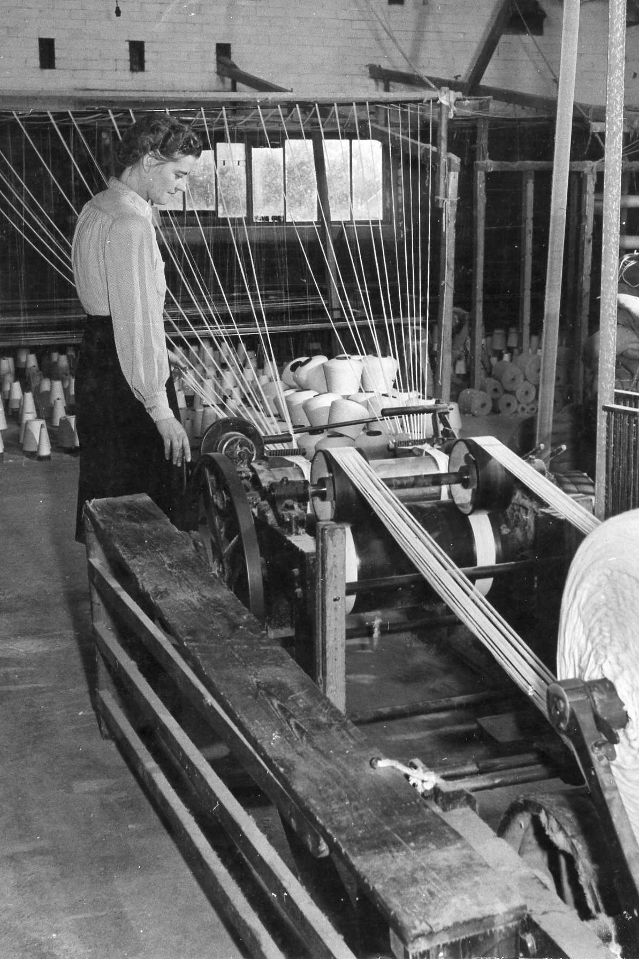
Not all nets were for fishing. This machine is sewing the top strip onto a tennis net. Bridport also made football nets, including for the World Cup in 1966.
This man is cutting lengths of twine to make fishing lines. In the background you can see packages of finished twine ready to be sold.
Here lots of bobbins are being used to make an enormously long line for cod fishing boats in Newfoundland

Slide 13
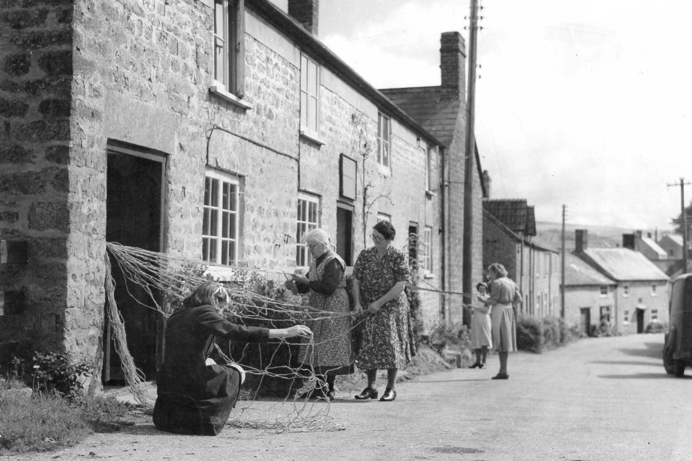
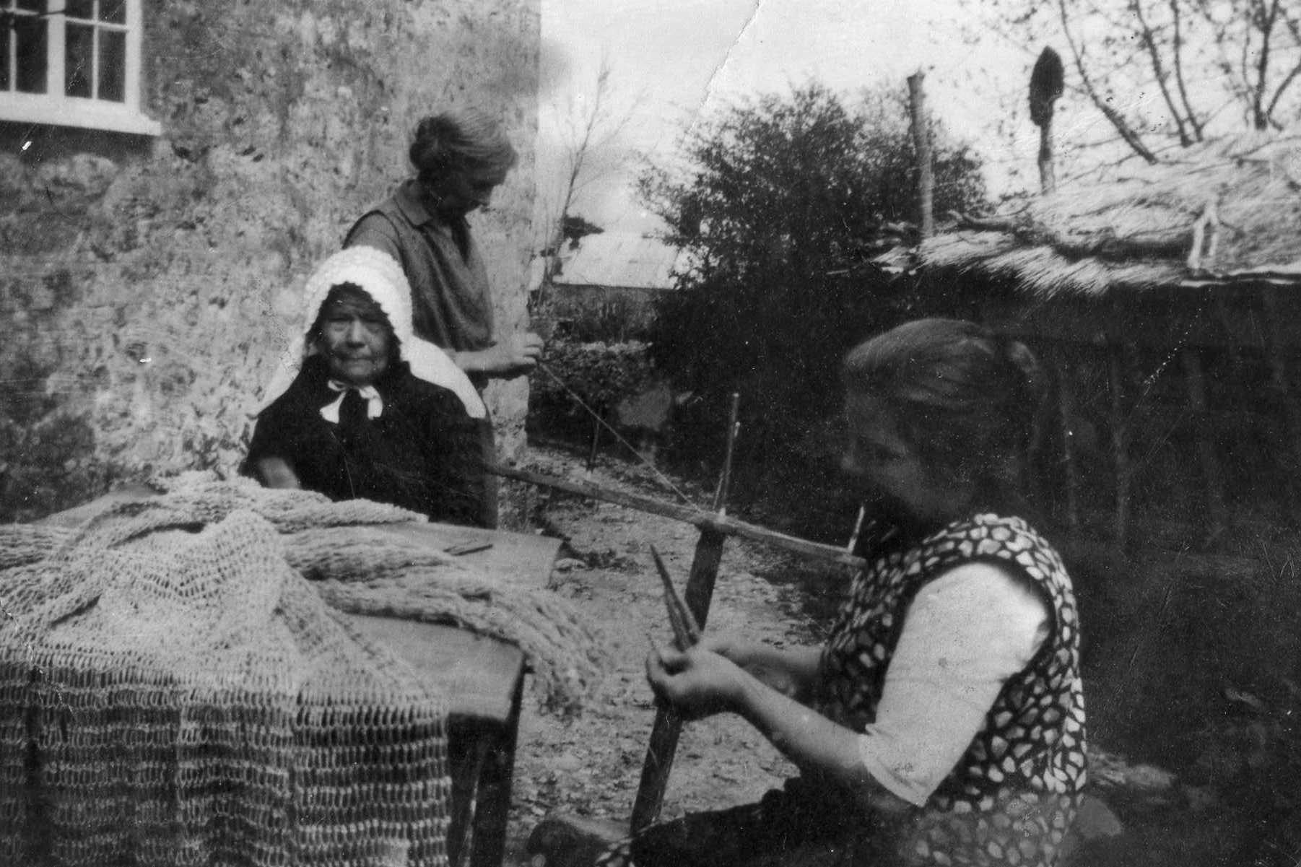
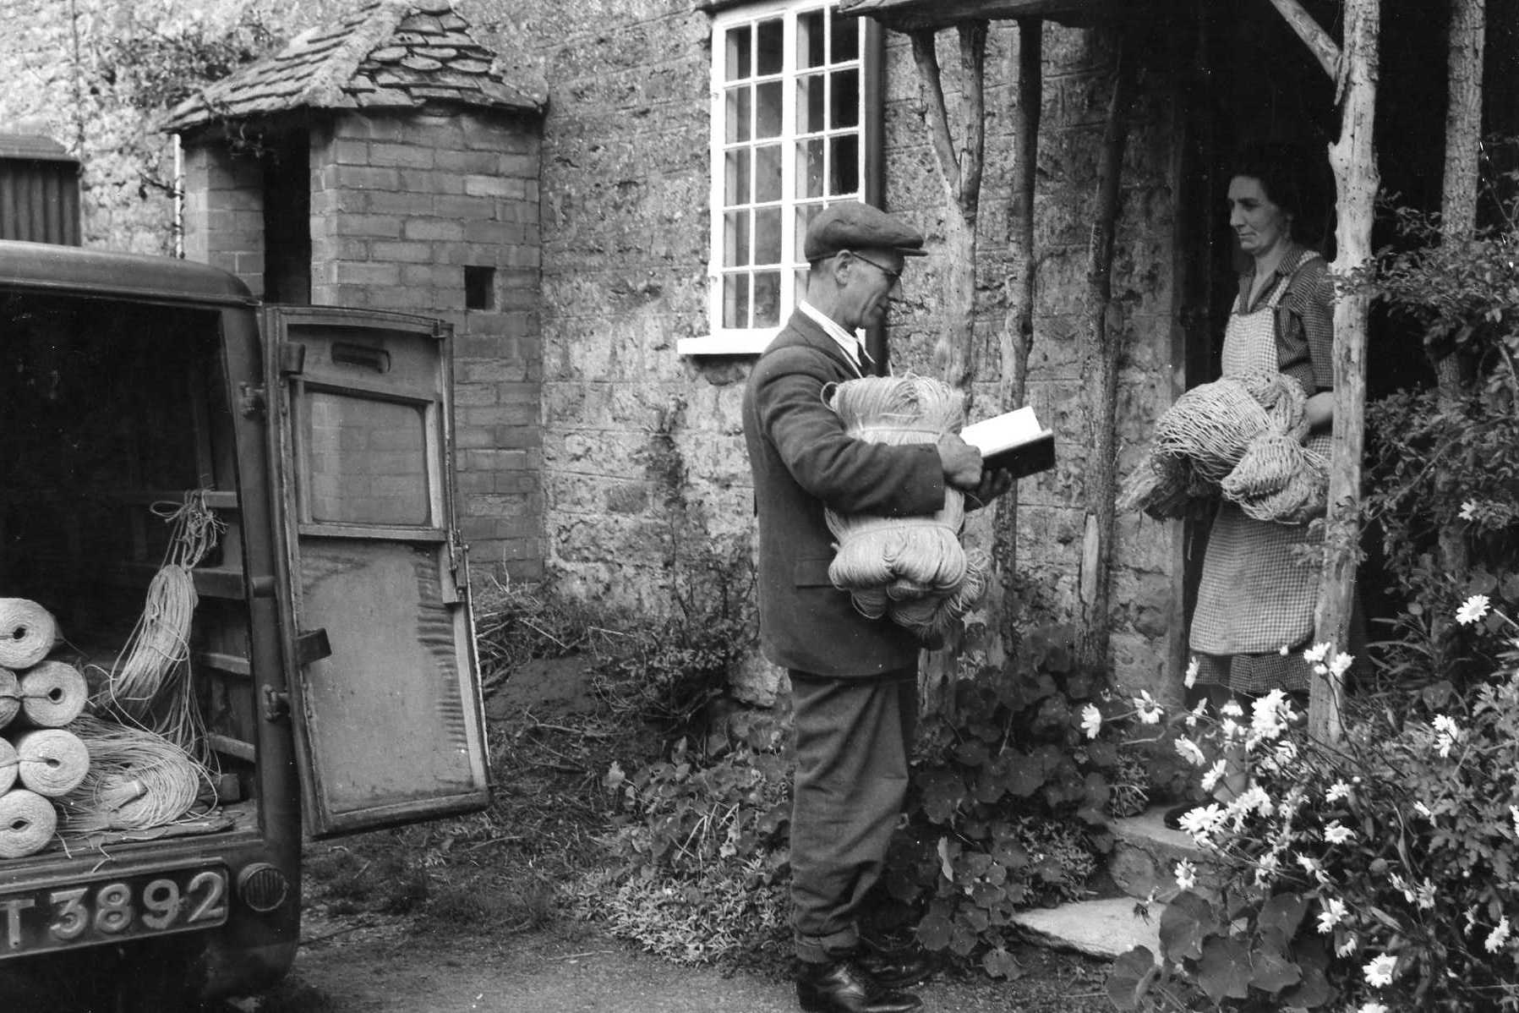
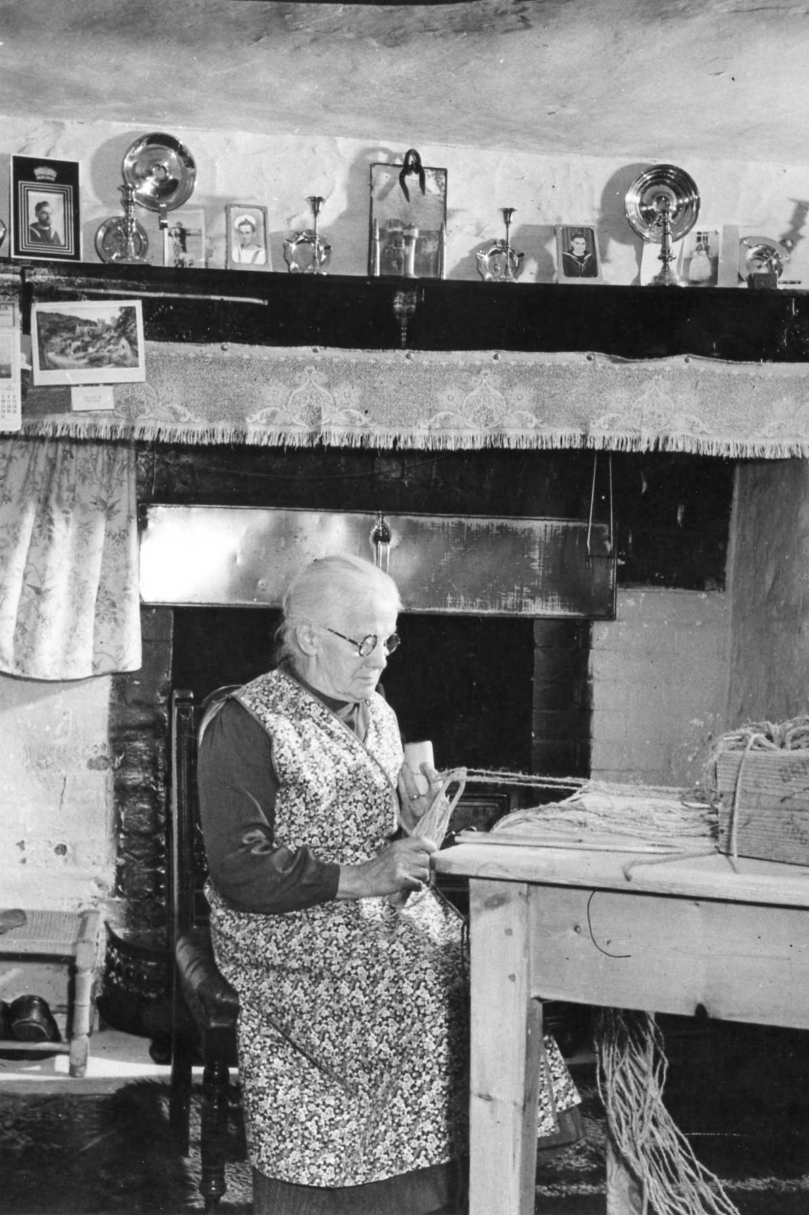
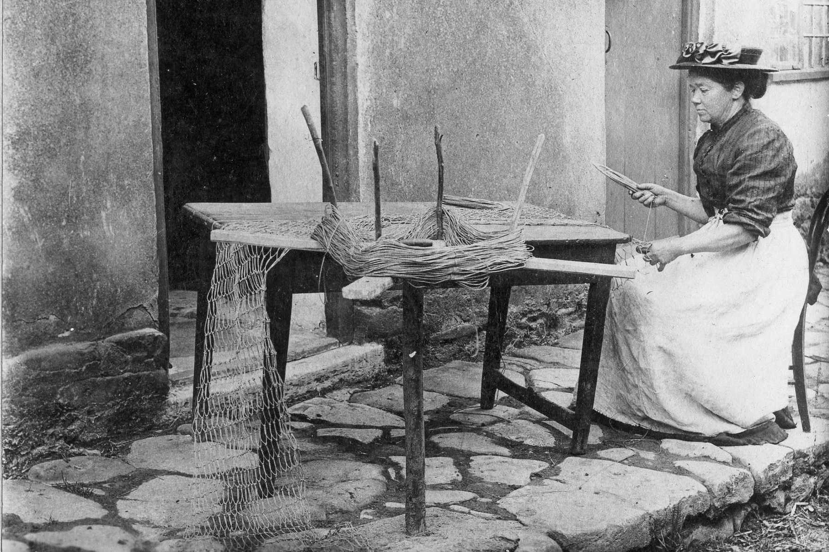
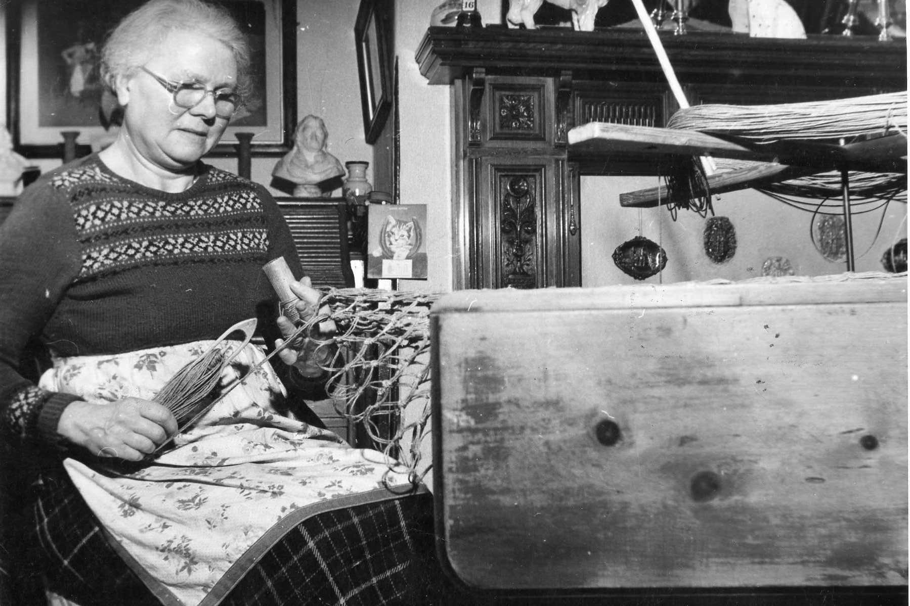
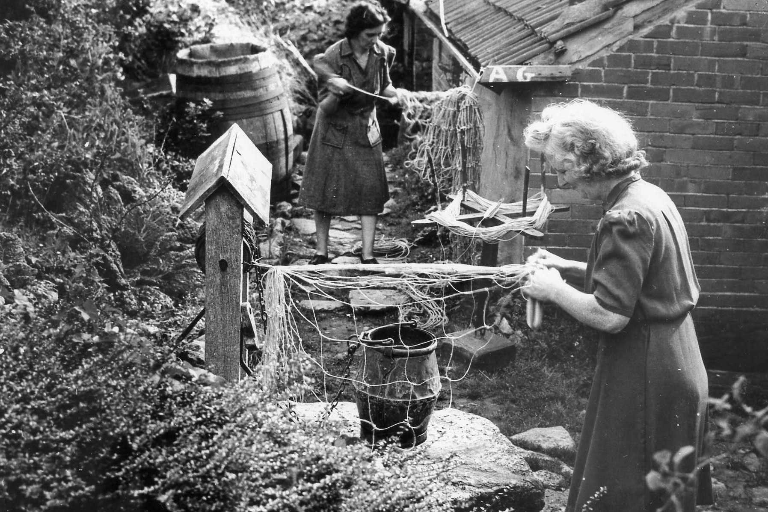
Mr Symes delivering twine to Mrs Greening and collecting nets she’s made.
Many local women made nets at home…
Women at Loders in the street outside their houses
Mrs Courtney & her daughter Puncknowle
Mrs Hodder Eype, 1913
Mrs Crabb Uploders
Mrs Legg Loders, 1948
Mrs Greening & Mrs Poole in their gardens, late 1940s.

Slide 14
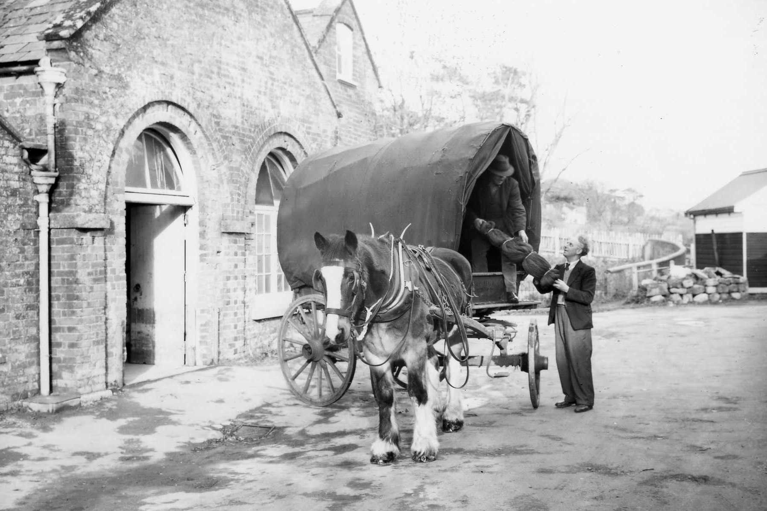
Taking finished nets to the station in 1950.

Slide 15
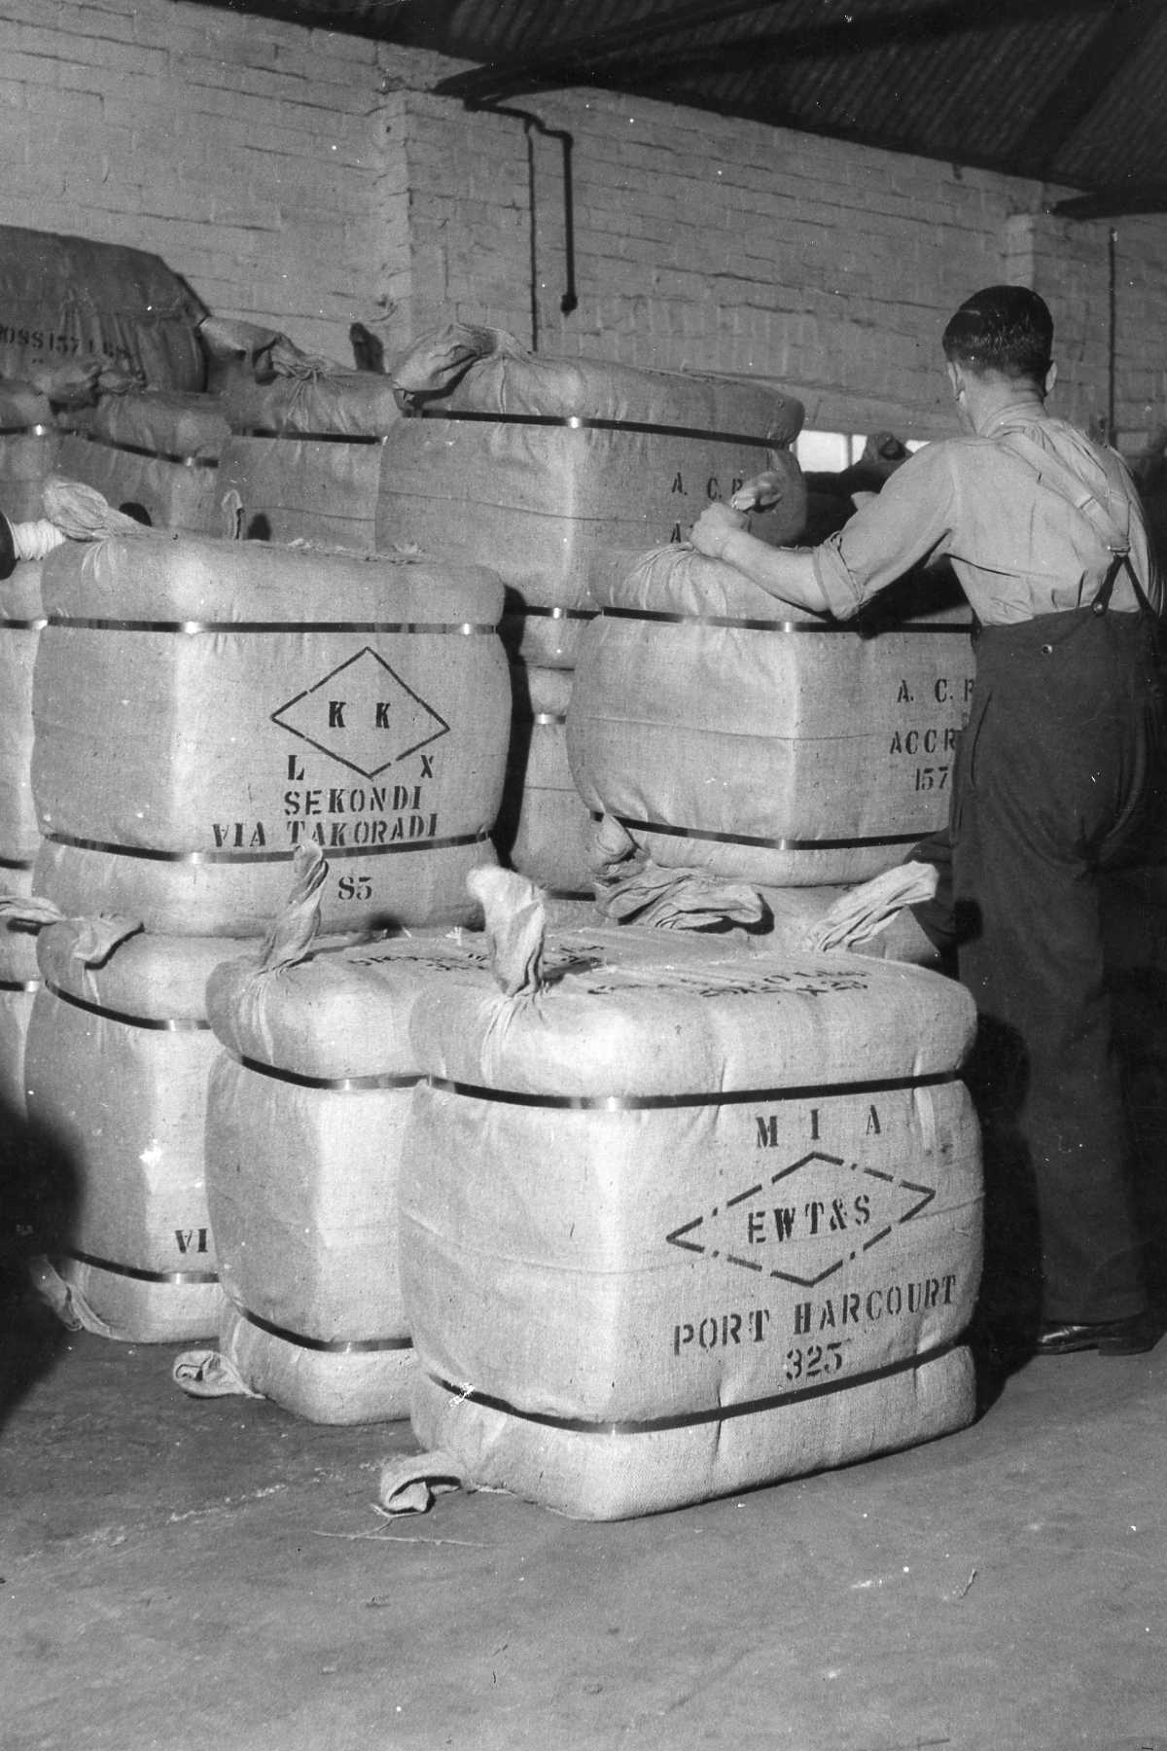
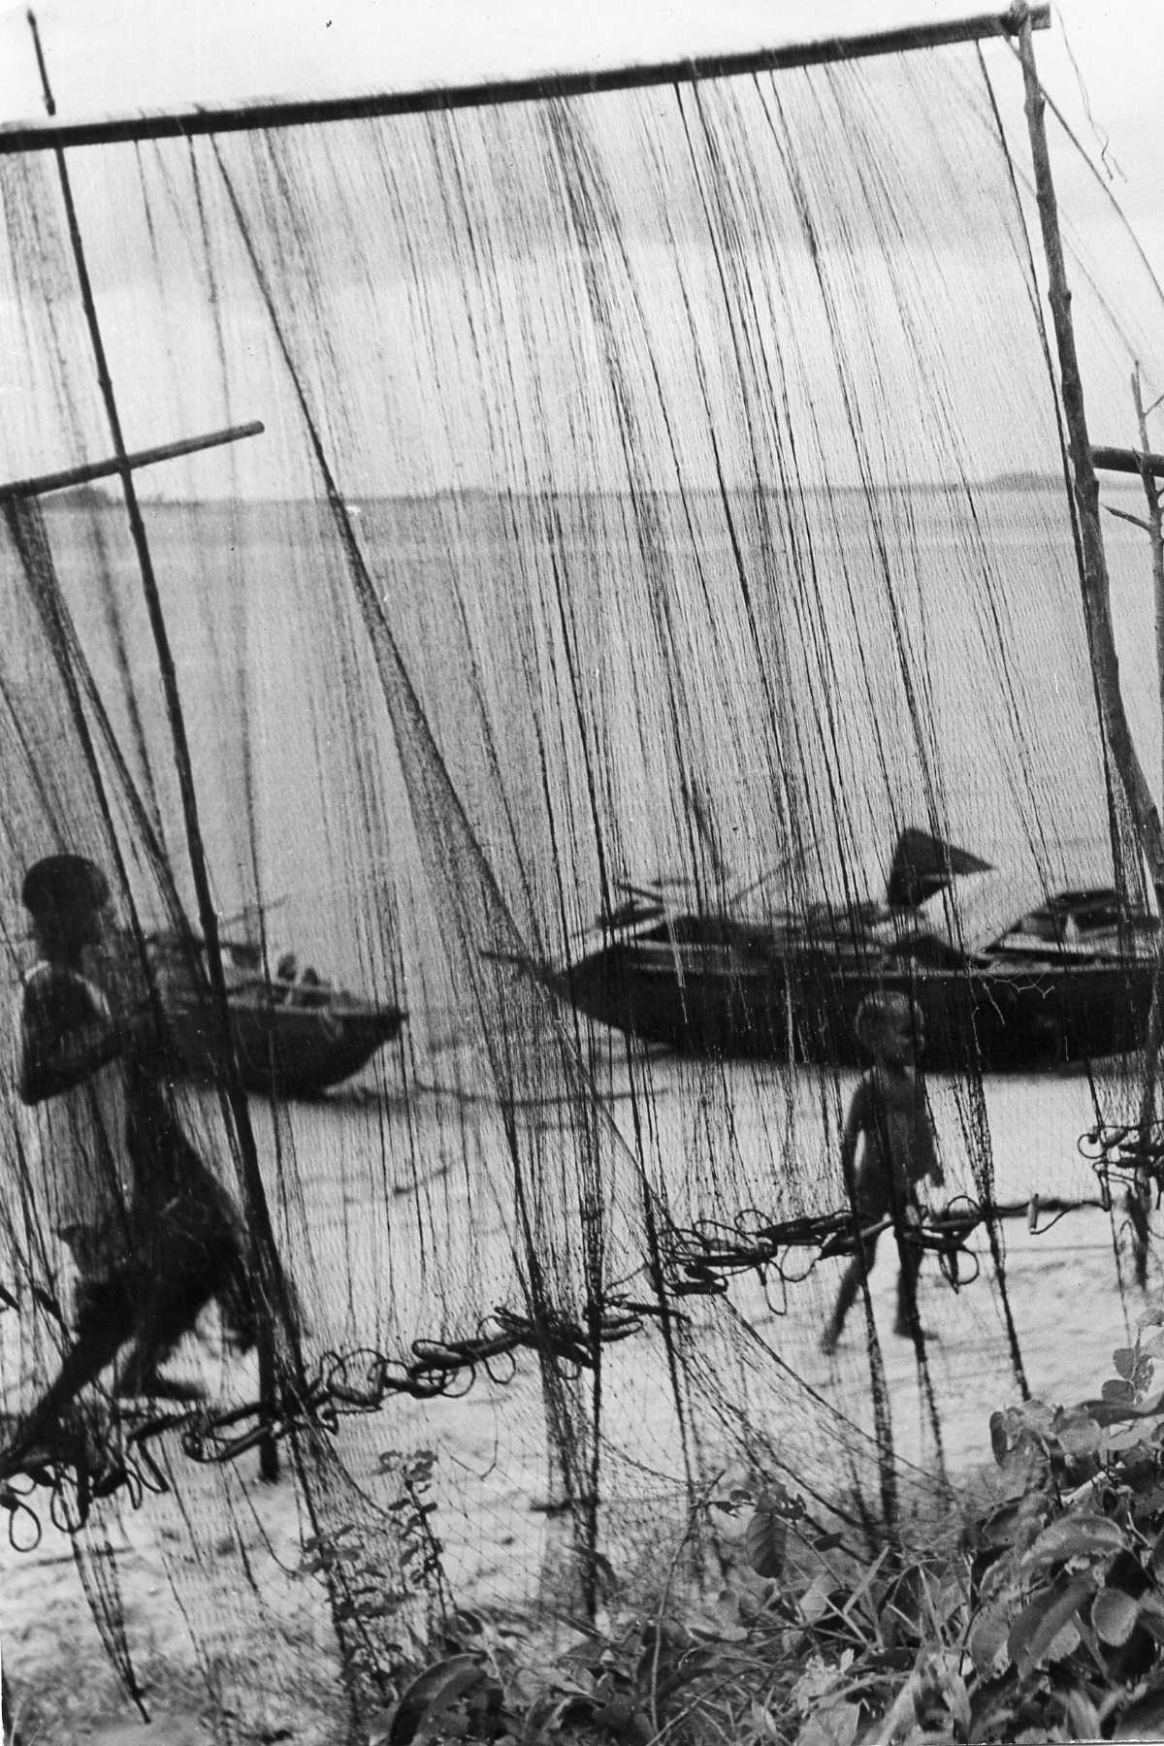
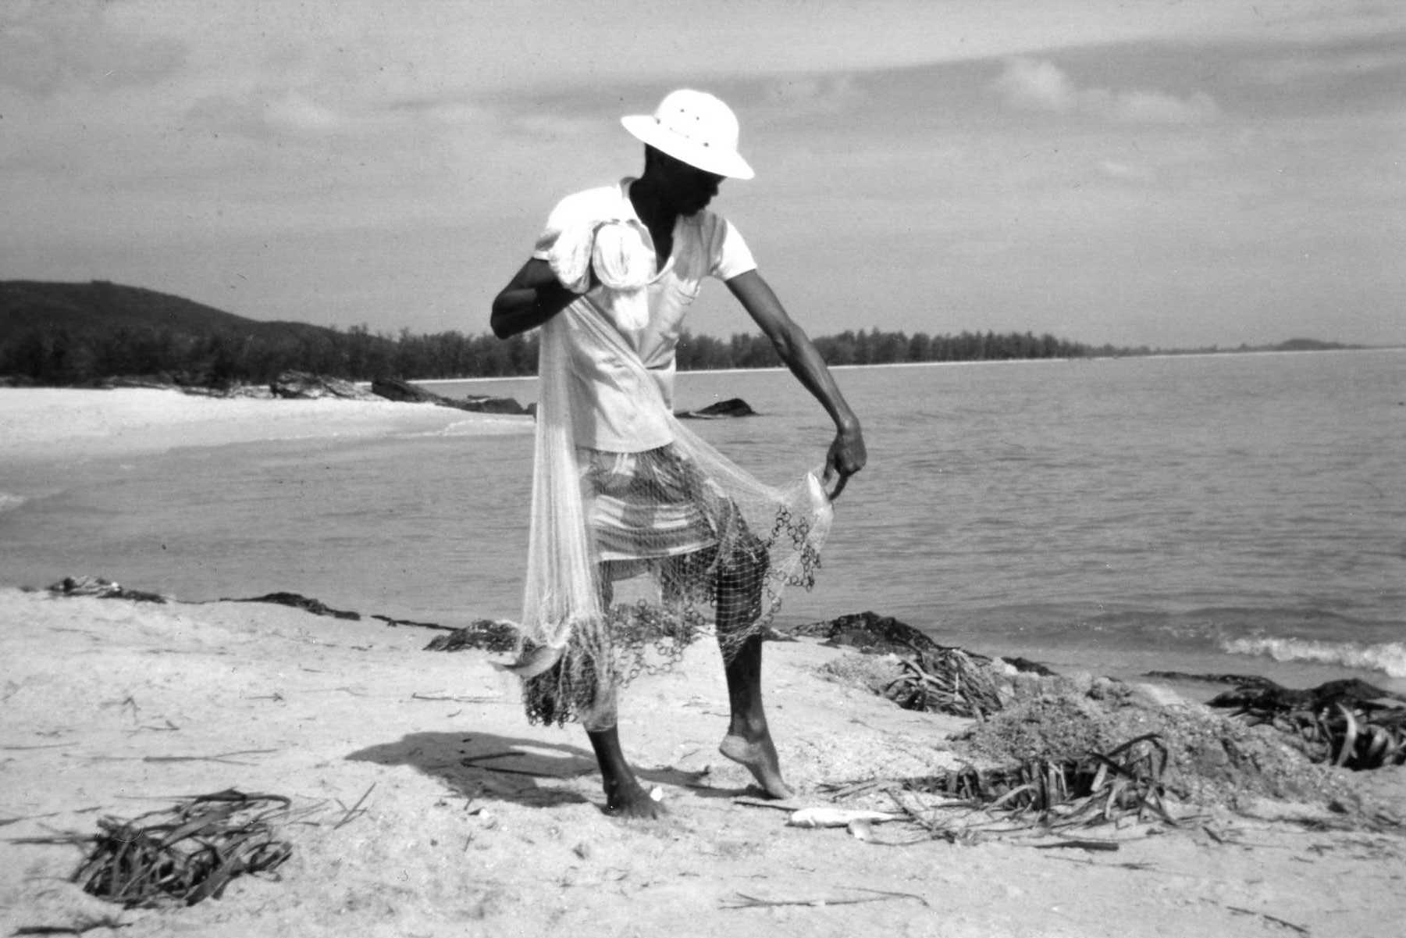
Bales of nets are ready for export by ship to Africa. They’re going to Port Harcourt and Takoradi.

Slide 16
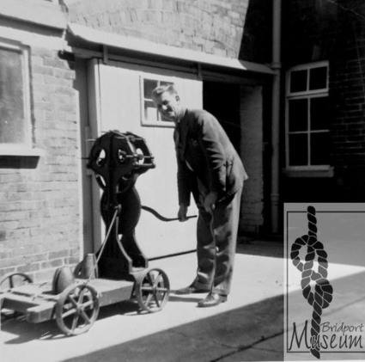
Rope & Net Making
in Pictures
Part 3: Rope

Slide 17
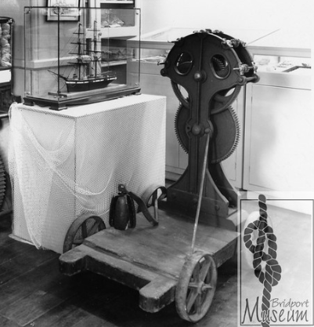
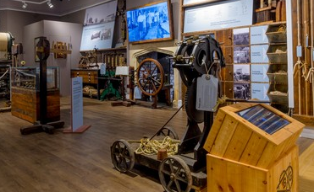
This is a “rope jack”, it was used to make rope by hand. Yarn is fixed to hooks in the jack, and at the other end to a hook on a wall. As you walk along the line of rope holding the wooden “top” it twists the strands together into rope.
You can come along to Bridport Museum to see rope making demonstrations using the rope jack we have in our gallery.

Slide 18





1
Bales of yarn ready for making rope in a factory. These big bales were known as “cheeses”
5
2
This picture shows you how long the “rope walks” were. Originally all this work would have been done outdoors
3
Making rope by machine. The big bundles of yarn are set out in long lines ready for twisting into rope.
4
Paying out lines of yarn ready to be twisted together into rope.
A close up of the lines of yarn

